Slide 1
Object-Oriented Programming Using C++
Third Edition
Class Features and Design Issues

Slide 2
Objectives
Classify the roles of member functions
Understand constructors
Write constructors both with and without arguments
Overload constructors
Create destructors
Object-Oriented Programming Using C++, Third Edition

Slide 3
Objectives (continued)
Understand composition
Learn how, why, and when to use the preprocessor directives #ifndef, #define, and #endif
Master techniques for improving classes and their functions
Object-Oriented Programming Using C++, Third Edition

Slide 4
Classifying the Roles of Member Functions
Inspector functions or access functions
  Return information about an object’s state, or display some or all of an object’s attributes
  getName() or displayValues()
  Predicate functions (subcategory): isDigit()
Mutator functions or implementors
  Change an object’s state or attributes
  setData() or computeValue()
Object-Oriented Programming Using C++, Third Edition

Slide 5
Classifying the Roles of Member Functions (continued)
Auxiliary functions or facilitators
  Perform some sort of action or service
  sortAscending() or findLowestValue()
Manager functions
  Create and destroy objects for you
  Called constructors and destructors
Object-Oriented Programming Using C++, Third Edition

Slide 6
Understanding Constructors
Constructor: function that is called automatically each time an object is created
Default constructor: no arguments
Non-default constructor: at least one argument
Object-Oriented Programming Using C++, Third Edition

Slide 7
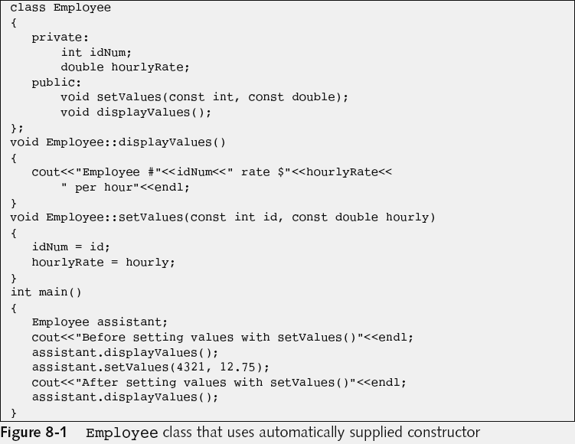
Writing Constructors without Arguments
Object-Oriented Programming Using C++, Third Edition

Slide 8
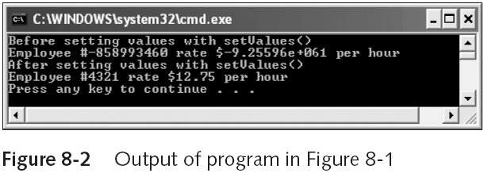
Writing Constructors without Arguments (continued)
Garbage
Object-Oriented Programming Using C++, Third Edition

Slide 9
Writing Constructors without Arguments (continued)
Default constructor: automatically supplied constructor that executes when you do not explicitly write one
Constructors differ from other member functions in that a:
  Constructor has the same name as its class
  Constructor cannot have a return type
Object-Oriented Programming Using C++, Third Edition

Slide 10
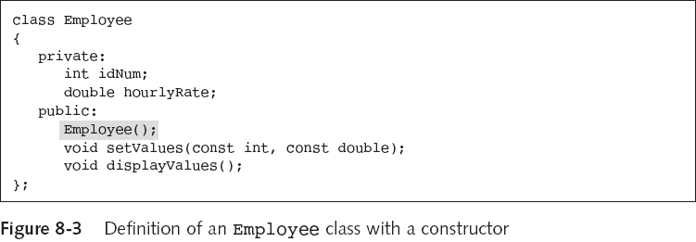

Writing Constructors without Arguments (continued)
Object-Oriented Programming Using C++, Third Edition

Slide 11
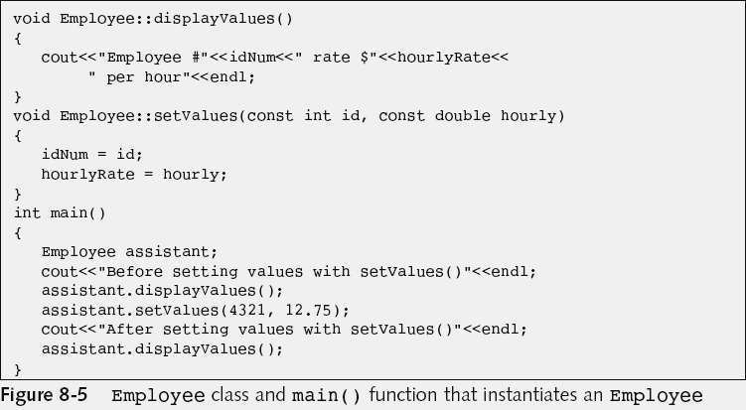
Writing Constructors without Arguments (continued)
…
Object-Oriented Programming Using C++, Third Edition

Slide 12
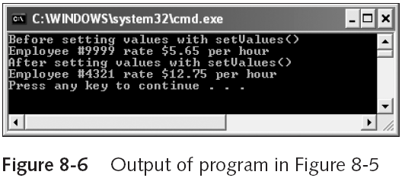
Writing Constructors without Arguments (continued)
Default value (as set by constructor)
Object-Oriented Programming Using C++, Third Edition

Slide 13
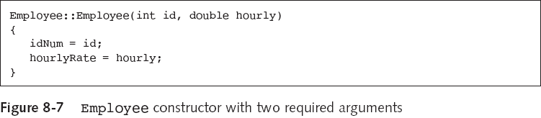
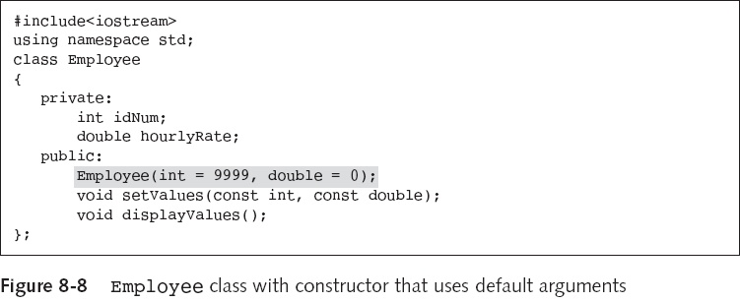
Writing Constructors with Arguments
Object-Oriented Programming Using C++, Third Edition

Slide 14
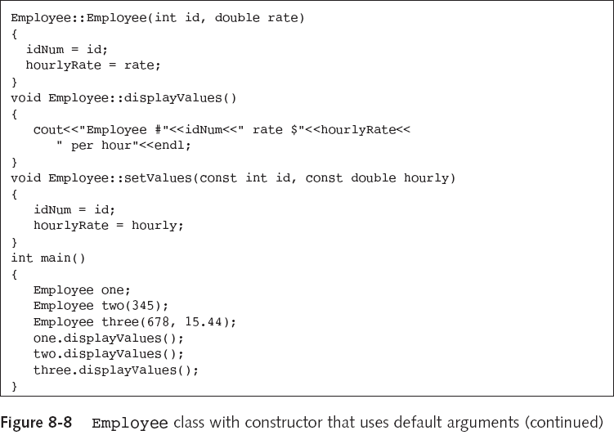
Pitfall: Using Parentheses When Instantiating an Object with a Default Constructor
Pitfall:
Employee one(); would be wrong!
Object-Oriented Programming Using C++, Third Edition

Slide 15
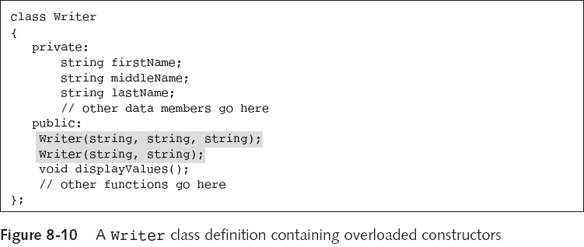
Overloading Constructors
Object-Oriented Programming Using C++, Third Edition

Slide 16
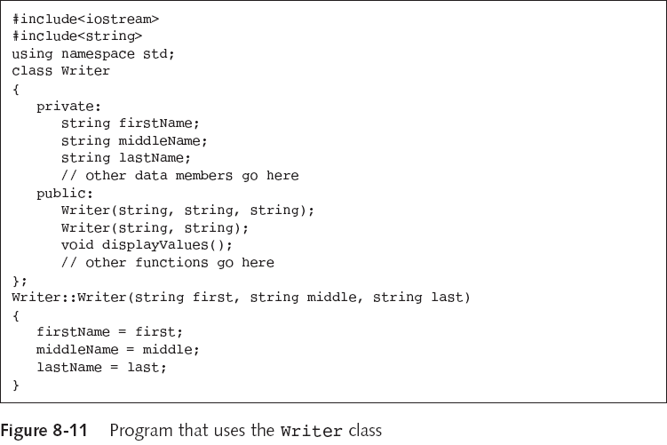
Overloading Constructors (continued)
Object-Oriented Programming Using C++, Third Edition

Slide 17
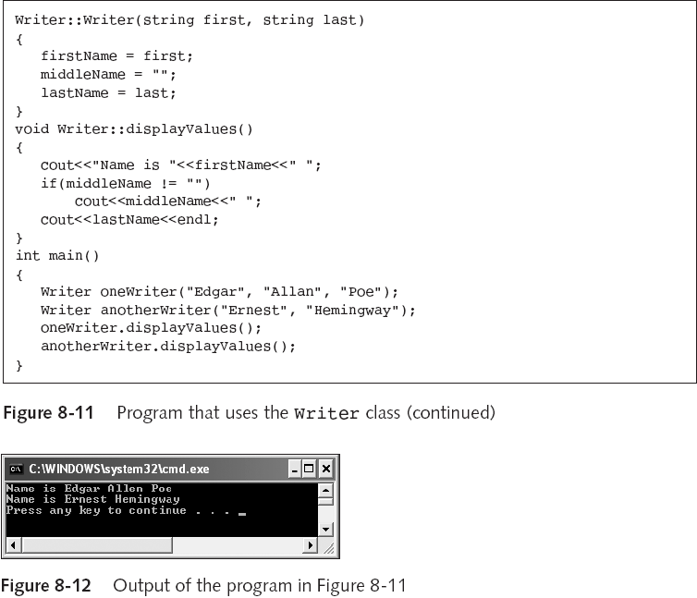
Overloading Constructors (continued)
Object-Oriented Programming Using C++, Third Edition

Slide 18
Using Destructors
Destructor function is called automatically when an object is destroyed
An object is destroyed when it goes out of scope
Rules for creating destructor function prototypes:
  Destructor function has the same name as its class, preceded with a tilde (~)
  Destructor function does not have a return type
  You cannot pass any values to a destructor
Object-Oriented Programming Using C++, Third Edition

Slide 19
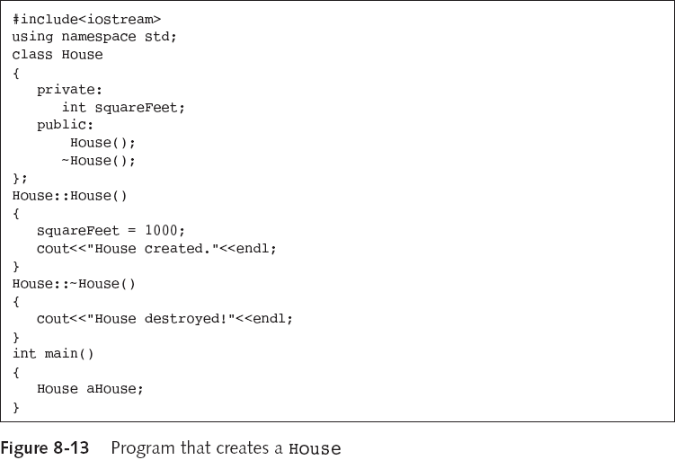
Using Destructors (continued)
Object-Oriented Programming Using C++, Third Edition

Slide 20
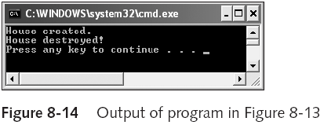
Using Destructors (continued)
Object-Oriented Programming Using C++, Third Edition

Slide 21
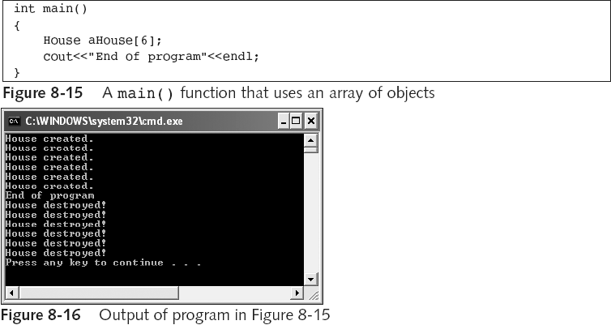
Using Destructors (continued)
Class must have a default constructor
Object-Oriented Programming Using C++, Third Edition

Slide 22
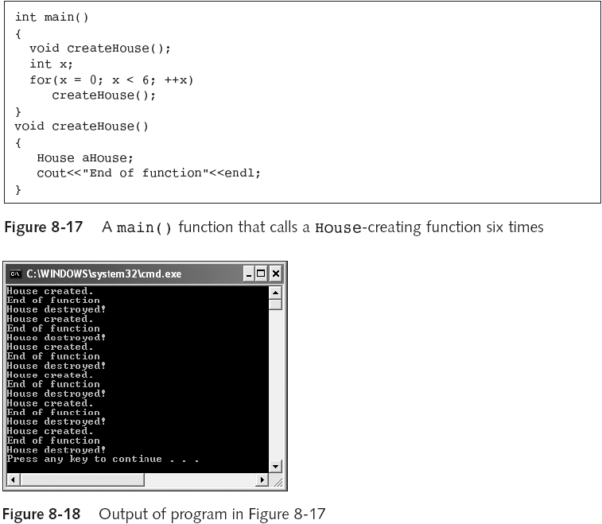
Using Destructors (continued)
Object-Oriented Programming Using C++, Third Edition

Slide 23
Understanding Composition
Composition: using a class object in another class
With composition, you can call the contained objects member-objects
The composition relationship is called a “has-a” relationship
  “A Transaction has an InventoryItem”
Object-Oriented Programming Using C++, Third Edition

Slide 24
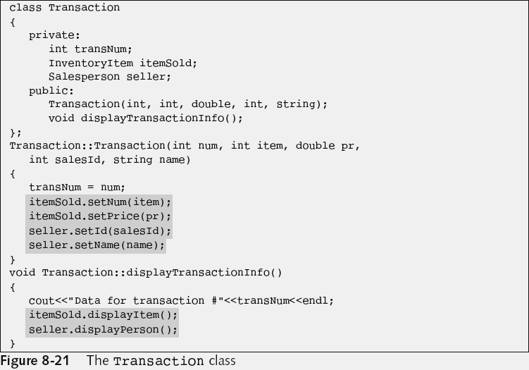
Understanding Composition (continued)
Object-Oriented Programming Using C++, Third Edition

Slide 25
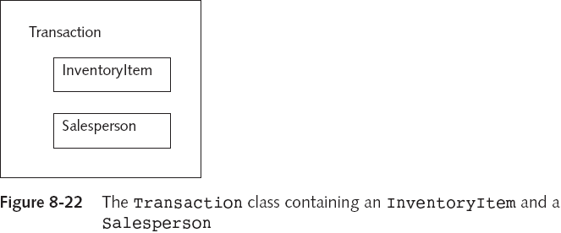
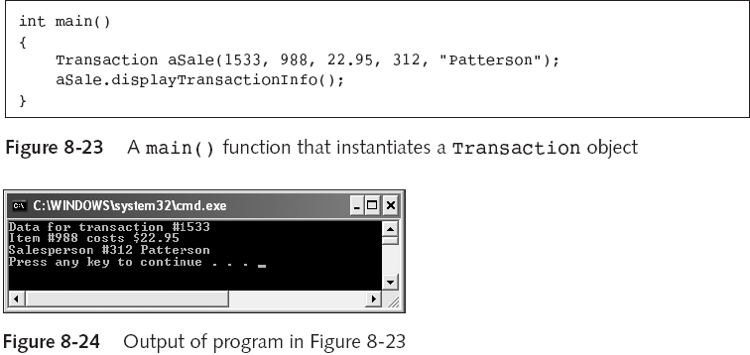
Object-Oriented Programming Using C++, Third Edition

Slide 26
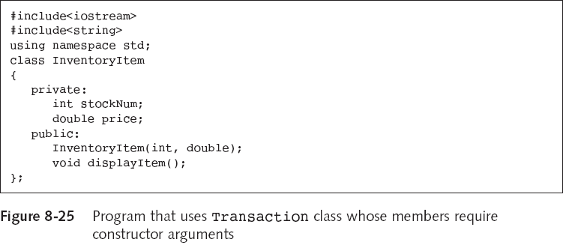
Using Composition When Member Classes Contain Non-Default Constructors
Object-Oriented Programming Using C++, Third Edition

Slide 27
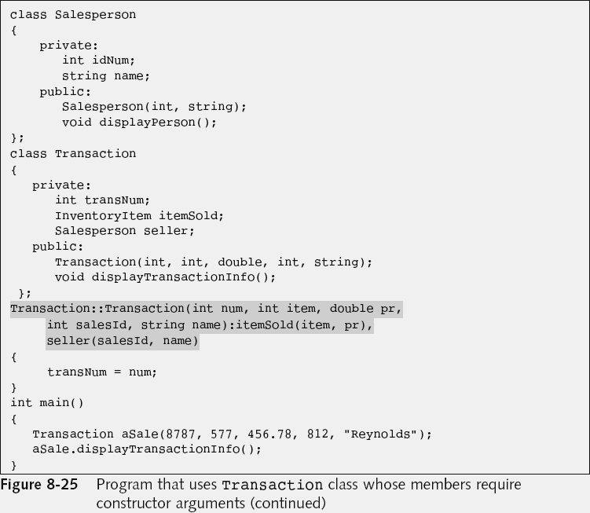
…
…
…
Initialization list
Object-Oriented Programming Using C++, Third Edition

Slide 28
Using #ifndef, #define, and #endif
Reusability is a major focus of OO thinking
Program maintenance is the upkeep of professional programs over time
Creating self-contained components such as InventoryItem that you include in other classes makes program maintenance easier
Library: collection of classes
Component reuse may lead to “multiple declaration” problem
Object-Oriented Programming Using C++, Third Edition

Slide 29
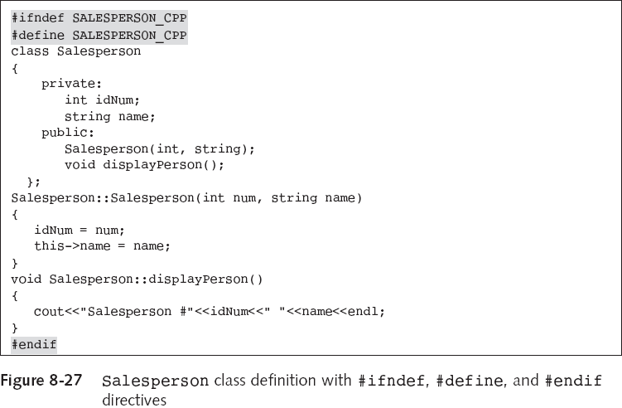
Using #ifndef, #define, and #endif (continued)
Object-Oriented Programming Using C++, Third Edition

Slide 30
Improving Classes and Their Functions
With larger programs, be sure to spend time on planning and design
To improve functions:
  Select meaningful names for member data and functions
  Reduce coupling between functions
  Increase cohesion within a function
Object-Oriented Programming Using C++, Third Edition

Slide 31
Selecting Member Data and Function Names
Use meaningful names
  Don’t use: someData, firstFunction()
Use pronounceable names
  Don’t use: zbq, goout()
Be judicious in your use of abbreviations
  Don’t use: getStat()
Avoid using digits in a name
  Zero (0) can be confused with ‘O’ or one (1) with ‘l’
  Don’t use: var1
  OK: budgetFor2008
Object-Oriented Programming Using C++, Third Edition

Slide 32
Selecting Member Data and Function Names (continued)
Use capitalization freely in multiword names
  Don’t use: initializeintegervalues()
  OK: initializeIntegerValues()
Include a form of “to be,” such as “is” or “are,” in names for variables that hold a status
  Don’t use: overdrawn
  OK: isOverdrawn
A verb-noun is a good combination for a function
  Example: computeBalance(), displayTotal()
Object-Oriented Programming Using C++, Third Edition

Slide 33
Selecting Member Data and Function Names (continued)
Use stubs during the initial phases of a project
Stubs: simple routines that do nothing (or very little); they act as placeholders
    double calculateInsurancePremium()
    {
    return 0.0;
    }
  This stub function can be called from the appropriate places within a developing program
Object-Oriented Programming Using C++, Third Edition

Slide 34
Reducing Coupling Between Functions
Coupling: strength of the connection between two functions
  Tight coupling: much dependence between functions; makes programs more prone to errors
  Loose coupling: occurs when functions do not depend on others
Reduce coupling as much as possible
  Connections between functions make them more difficult to write, maintain, and reuse
Object-Oriented Programming Using C++, Third Edition

Slide 35
Increasing Cohesion Within a Function
Cohesion: how well the operations in a function relate to one another
Functional cohesion: all function operations contribute to the performance of only one task
Strive for functional cohesion:
    double square(double number)
    {
    return (number * number);
    }
Object-Oriented Programming Using C++, Third Edition

Slide 36
You Do It: Creating a Class with a Constructor
Pizza::Pizza(const string top, const int size, const double price)
{
topping = top;
diameter = size;
this->price = price;
}
Object-Oriented Programming Using C++, Third Edition

Slide 37
Using Constructor Parameters
int main()
{
Pizza stdPizza;
Pizza special(“pineapple”);
Pizza deluxeSpecial(“sausage”, 16);
Pizza veryDeluxeSpecial(“lobster”, 20, 17.99);
cout<<”The standard pizza is: “;
stdPizza.displayValues();
cout<<”Today's special is “;
special.displayValues();
cout<<”The deluxe special is “;
deluxeSpecial.displayValues();
cout<<”And the very deluxe special is “;
veryDeluxeSpecial.displayValues();
}
Object-Oriented Programming Using C++, Third Edition

Slide 38
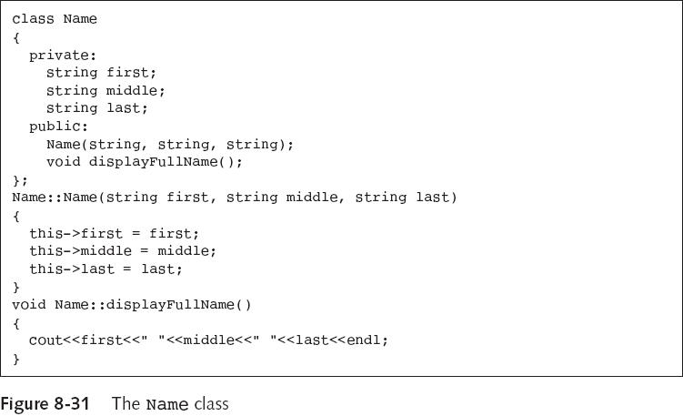
Understanding Composition
Object-Oriented Programming Using C++, Third Edition

Slide 39
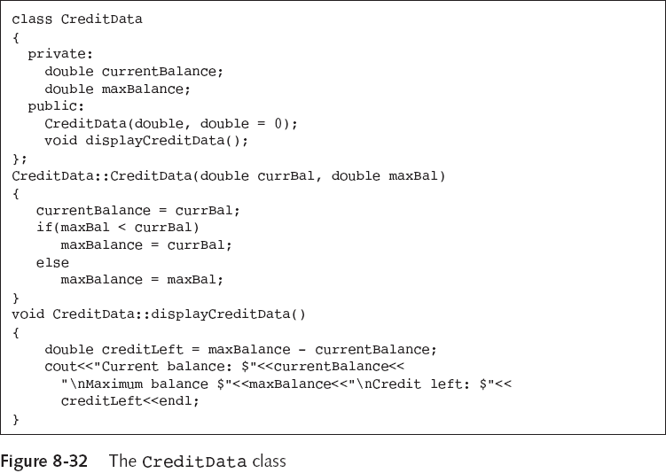
Understanding Composition (continued)
Object-Oriented Programming Using C++, Third Edition

Slide 40
Summary
The four basic groups of member functions include: inspector functions, mutator functions, auxiliary functions, and manager functions
A constructor is a function that is called automatically each time an object is created
Write constructors if you want specific tasks performed when an object is instantiated
Constructor header can contain an argument list
Constructors can be overloaded
Object-Oriented Programming Using C++, Third Edition

Slide 41
Summary (continued)
A destructor is a function that is called automatically each time an object is destroyed
Composition is when you use a class object within another class object
Reusability is a major focus of object-oriented thinking
With larger and more complicated programs, be sure to spend time on planning and design
Object-Oriented Programming Using C++, Third Edition

